Slide 1
Introduction to Fluorescence & Absorbance
Jacob Beal
iGEM Measurement Summer Webinar: Quantifying fluorescence and cell count with plate readers
July 14th, 2020
This document does not contain technology or technical data controlled under either U.S. International Traffic in Arms Regulation or U.S. Export Administration Regulations.

Slide 2
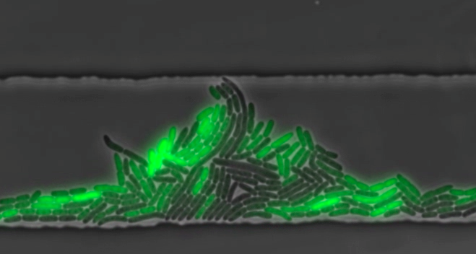
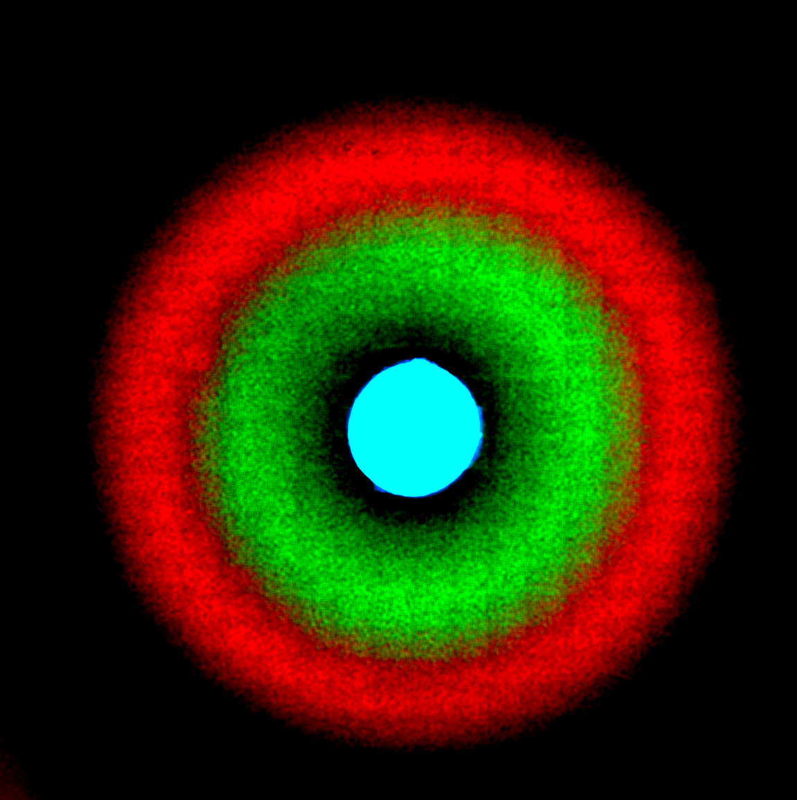
Fluorescent Protein = Debugging Output
[Weiss]
[Tsien Lab]
Up to ~15 boolean, ~3-4 precision quantification
[Hasty]

Slide 3
Picking your instrument
Today’s focus
 | Fluorimeter | Plate Reader | Flow Cytometer | Fluorescence Microscope
Throughput | Low | High | High | Low - High
Resolution | Population | Population | Single Cell | Subcellular
Time Series | Yes | Yes | No | Yes
Dynamic Range | 2-3 logs | 2-3 logs | 3-6 logs | 1-2 logs
# cells | n/a | n/a | High | Low
Of course, your resources and instructors matter most…

Slide 4
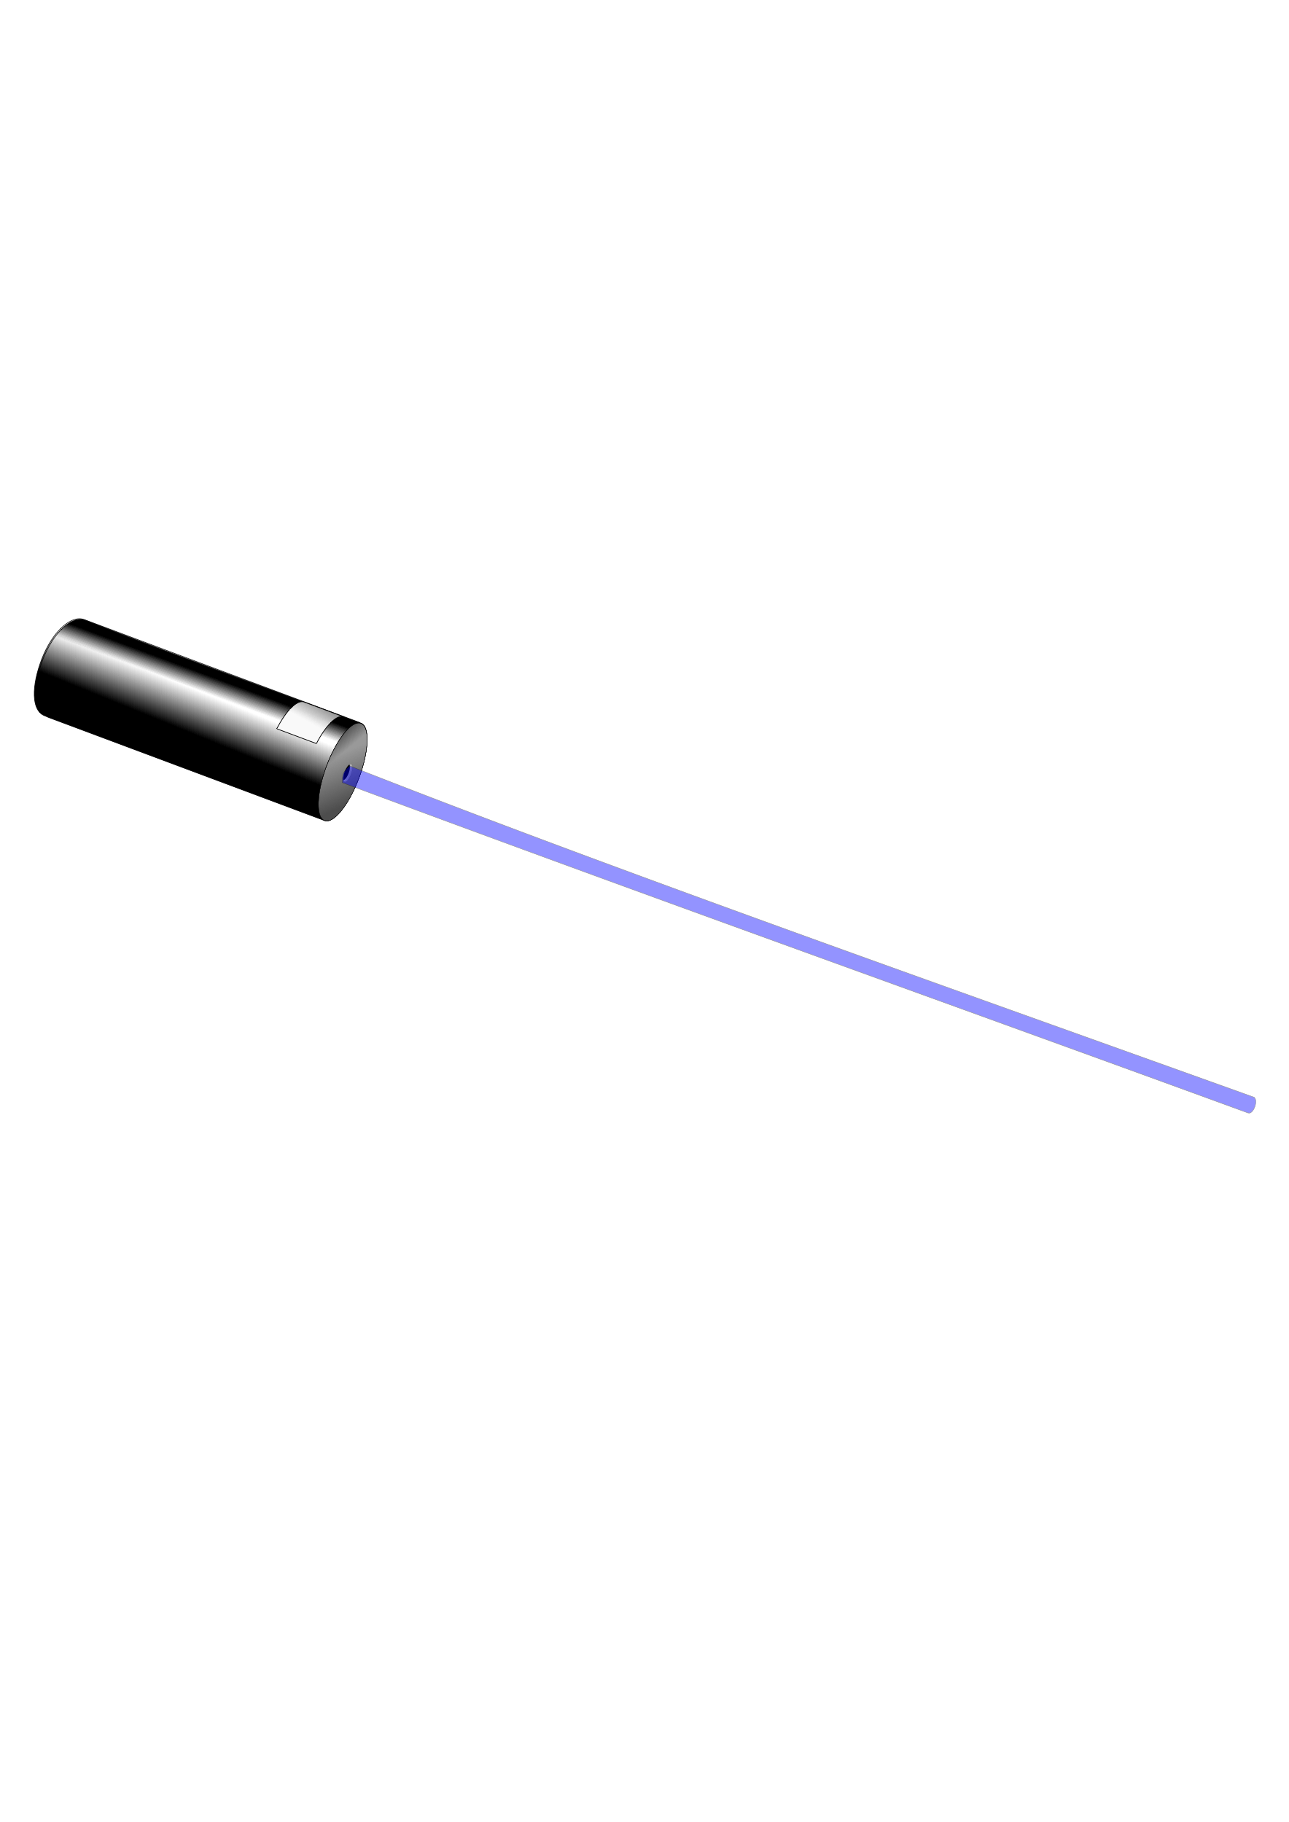
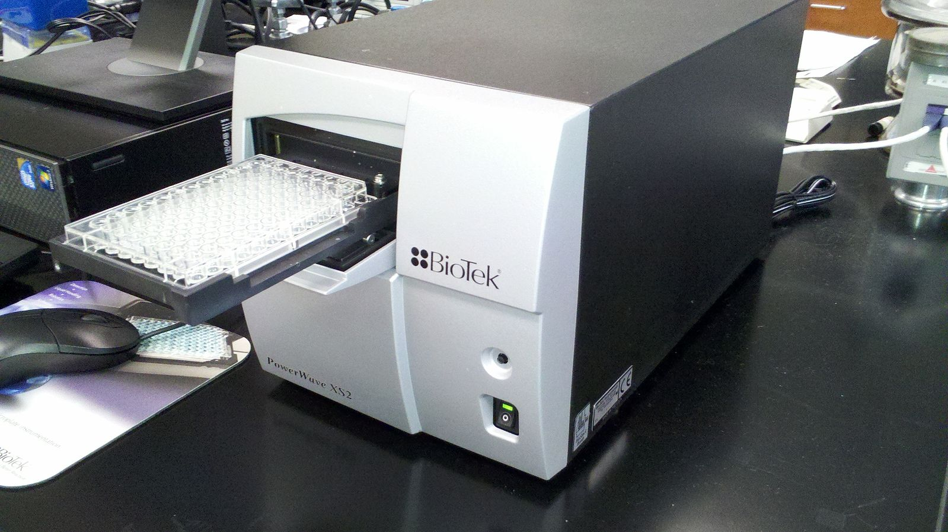
How a plate reader works
excitation light / laser
microplate
movable carrier
splitting
mirror
filters
fluorescence
detector
absorbance
detector

Slide 5
How Absorbance (OD) Works
light source
absorbance
detector
Cells (and other particles) scatter and absorb light
Optical Density (OD) = log₁₀ (source / detector)
Fraction of light detected depends on particle density, particle opacity, path length
Scattering also depends on frequency (typically 600nm)
Absorbance per cell linear at low OD (< ~0.5), highly non-linear at high OD (> ~2.0)

Slide 6
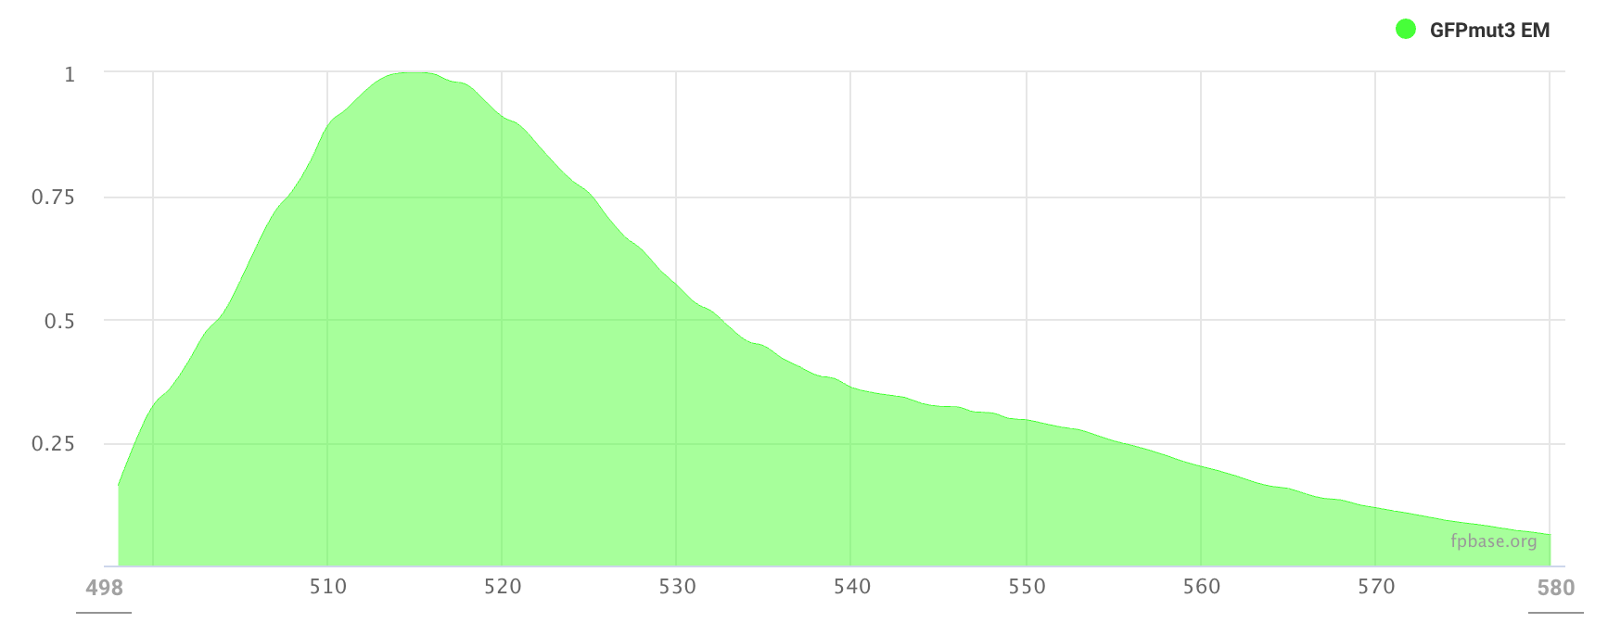
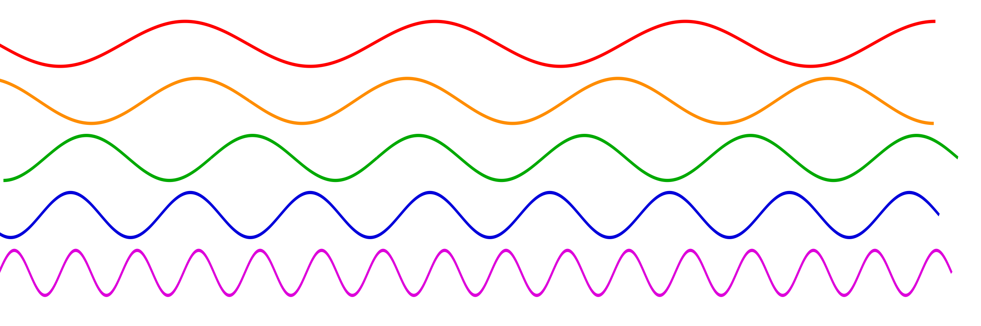
How Fluorescence Works
incoming excitation light
fluorescent
molecule
light emission at lower frequencies
Great signal, proportional to number of molecules
Exact unit relation in context is highly sensitive, hard to calculate

Slide 7
Factors affecting fluorescence measures
Molecule:
Excitation and emission spectrum
Brightness / quantum yield
Proper folding
Quenching from binding to other molecules
Sample:
pH, oxygenation
Background fluorescence: media, cell (can vary with cell state)
Other fluorescent molecules (spectral overlap)
Sample volume, orientation
Instrument
Excitation strength, frequency
Emission filters, light path
Overlap of excitation and emission
Detector amplification
Fluorescence always needs calibration to independent standards & process controls

Slide 8
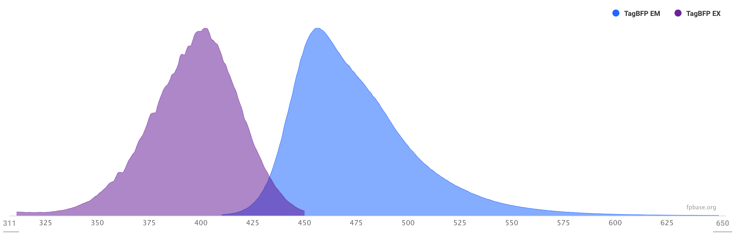
Excitation and Emission Spectra
Excitation spectrum:
Relative efficacy in stimulating emission
Emission spectrum:
Distribution of stimulated light

Slide 9
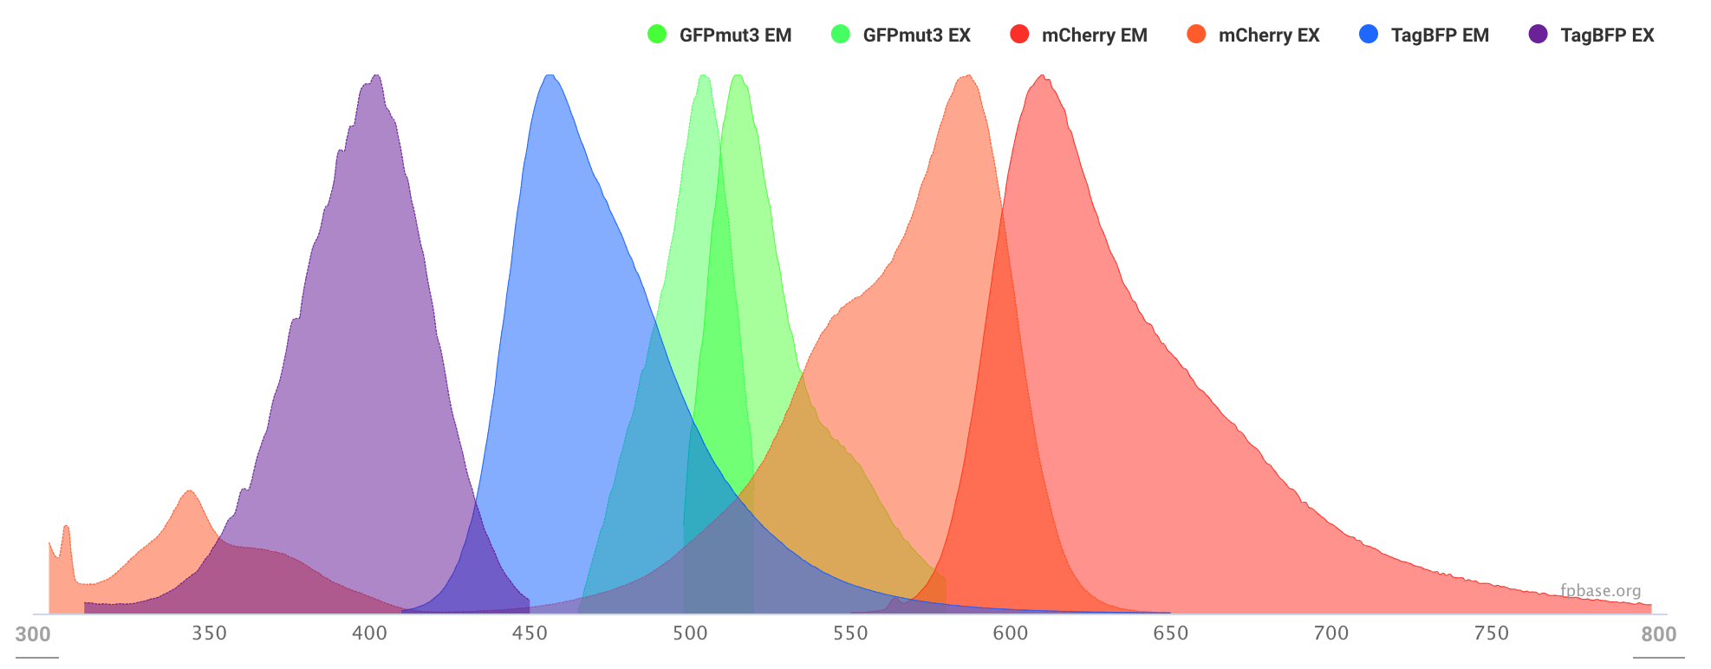
Excitation and Emission Spectra
Spectra should match your instrument capabilities, not overlap significantly
Minor overlap (recommend <3%) can be disentangled with a linear transform

Slide 10
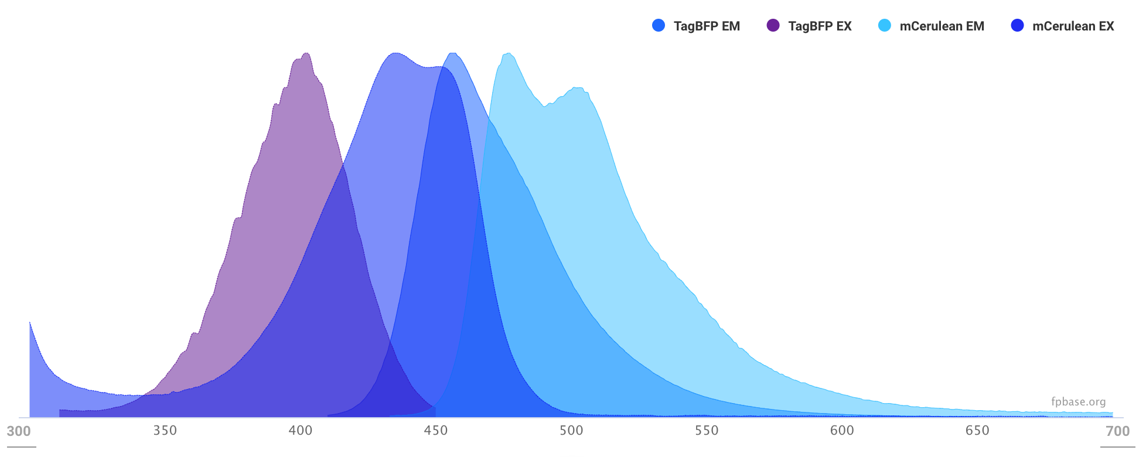
Poorly Separated Excitation & Emission
TagBFP and mCerulean can be distinguished, but are too close for good quantification

Slide 11
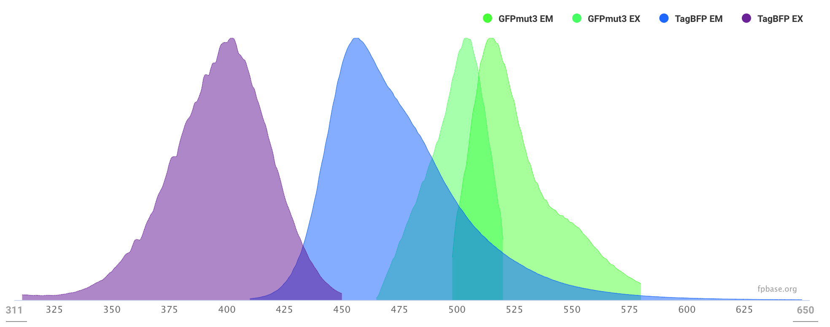
Separated by Excitation
TagBFP and GFPmut3 are excited by different wavelengths, thus do not overlap in readings

Slide 12
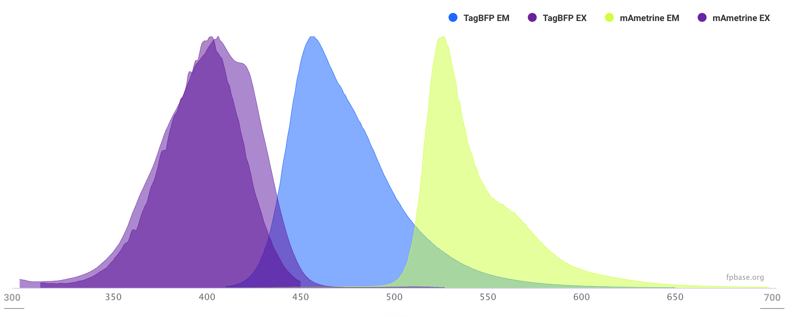
Separated by Emission
TagBFP and mAmetrine are excited similarly, but emission is sufficiently separated.
Useful if your instrument cannot do multiple independent excitations

Slide 13
Recommended Fluorescent Proteins
Green Fluorescent Proteins
BBa_E0040: GFPmut3 (Excit. 500 / Emiss. 513, brightness 35, maturation time 4.1 min, weak dimer).
BBa_K864100: sYFP2 (Excit. 515 / Emiss. 527, brightness 68, maturation time 4.1 min).
Calibrant: fluorescein
Red Fluorescent Proteins
BBa_J06504: mCherry (Excit. 587 / Emiss. 610, brightness 16, maturation time 15 min, pKa 4.5).
mKate2 (Excit. 588 / Emiss. 633, brightness 25, maturation time 20 min, pKa 5.4).
If a slow maturation time is acceptable:
BBa_E1010: mRFP1 (Excit. 584 / Emiss. 607, brightness 12.5, maturation time 60 min, pKa 4.5).
mScarlet (Excit. 569 / Emiss. 594, brightness 70, maturation time 174 min, pKa 5.3).
Calibrants: Texas Red, Nile Red
Blue Fluorescent Proteins
BBa_K592100: TagBFP (Excit. 402 / Emiss. 457, brightness 33, maturation time 13 min, pKa 2.7).
If a slow maturation time is acceptable:
Cerulean3 (Excit. 433 / Emiss. 475, brightness 35, maturation time 70 min, pKa 3.2).
Calibrants: Coumarin 30 (not yet verified)

Slide 14
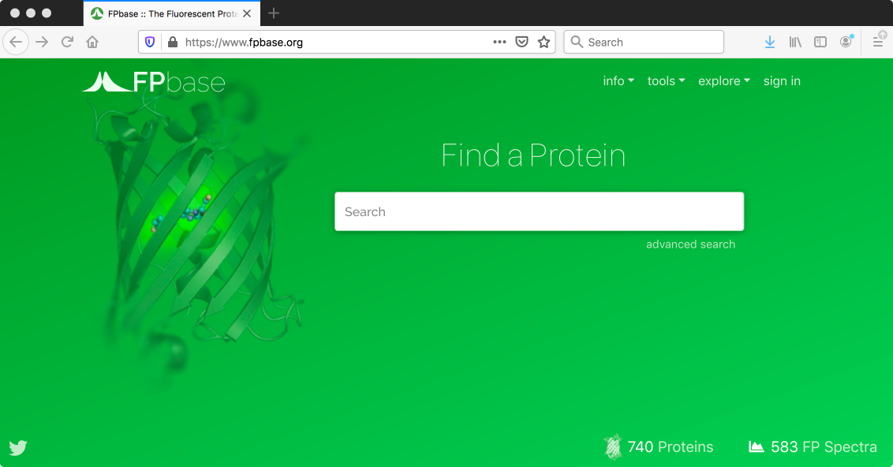
If you need other proteins:
For more proteins & spectra, fpbase.org is an excellent resource!

Slide 15
Summary
Fluorescence is a valuable biological debugging tool
Different instruments are good for different purposes
Plate readers are good for tracing time series
Flow cytometers are good for quantifying cell behavior
Microscopes are good for spatial arrangement and subcellular structure
Plate readers typically measure both absorbance (OD) and fluorescence
Fluorescence is affected by many factors, so measurements must be calibrated
Fluorescent proteins should be chosen to match calibrants and not interfere with each other

Slide 16
Calibration of Plate Reader Fluorescence and OD Measurements
Jacob Beal
iGEM Measurement Summer Webinar: Quantifying fluorescence and cell count with plate readers
July 14th, 2020
This document does not contain technology or technical data controlled under either U.S. International Traffic in Arms Regulation or U.S. Export Administration Regulations.

Slide 17

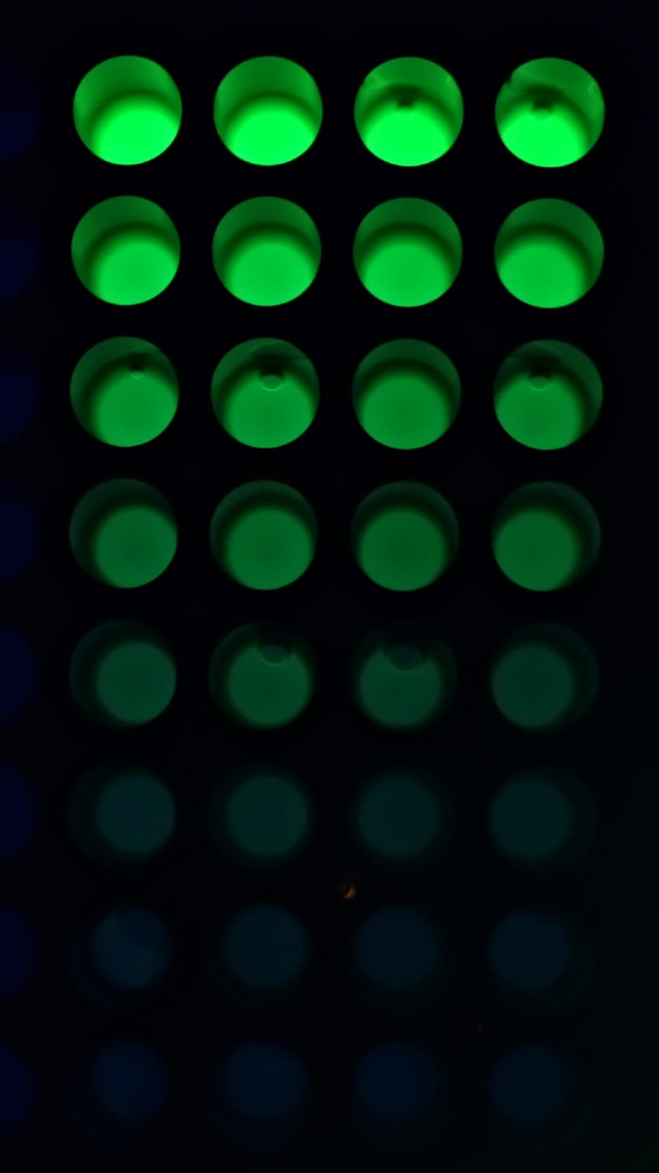
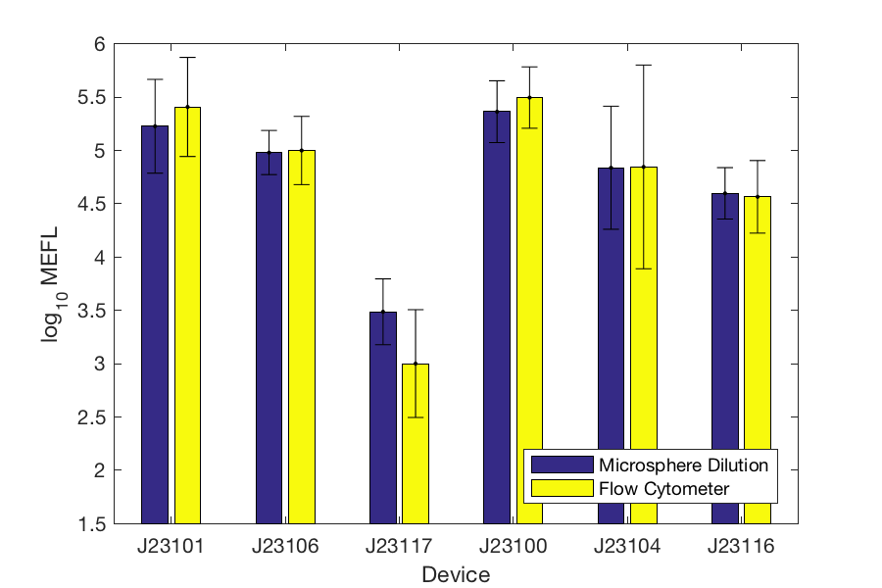
iGEM Plate Reader Calibration Protocol
Calibration with serial dilutions of cheap, stable materials
GFP: fluorescein (Sigma 46970), RFP: Texas Red (Sigma S3388)
OD: Monodisperse silica beads (Nanocym 950nm)
Produces MEFL units directly comparable w. flow cytometry, models
Highly replicable & debuggable measurements (1.8x geo.std.)
Validated with large-scale interlab study (244 institutions)
[Beal et al., ‘18, Beal et al., ‘19]
Notes:
Previously we recommended monodisperse silica beads from Cospheric, but they no longer sell the right diameter.

Slide 18
Calibration Process
Running the calibration protocol: https://2020.igem.org/Measurement/Protocols
Serial dilution of monodisperse silica particles
Serial dilution of each fluorescent dye
Enter all values in provided Excel sheet to calculate
Instrument settings must be identical for calibration and experiment!
Turn off instrument auto-calibration! (e.g., path length correction, auto-gain)
Re-run calibration at least monthly (preferably weekly), to ensure nothing changes

Slide 19
Serial Dilutions
Stock concentrations:
OD: 3.00E+09 Particles / mL
Fluorescein: 10 μM
Texas Red: 2 μM
Example of a good fluorescence series
Should be adaptable to other cell types by changing particle diameter, other fluorescence by changing calibrating dye

Slide 20
Example of Good Calibration
3.26E+08 particles / Abs600
Valid for Abs600 > 0.043
4.70E+09 MEFL / a.u.
Valid for a.u. > 47
For most instruments, effective dynamic range of fluorescence is larger than for OD

Slide 21
Problem: Inconsistent Dilution
If not linear in log scale (except for saturation), check data entry and/or redo pipetting

Slide 22
Problem: Narrow Range
Only about 4x from highest to lowest range → adjust instrument settings
OD range should be at least 20x
Fluorescence range should generally be larger, depending on machine

Slide 23
Problem: Negative Values
Readings should all be positive → instrument needs maintenance / reconfiguration

Slide 24
Automated Calibration Validation
https://github.com/iGEM-Measurement-Tools/Excel_Process_Validator
Found Excel file iGEM 2019 Plate Reader Fluorescence Calibration - Example.xlsx
All expected sheets are present
Template appears to be intact
All variables were extracted
Sufficient dynamic range of Abs600 calibration values: 31.46
Found a sufficiently long particle dilution slope from column 1 to 7
Computed mean particles / Abs600 is positive
All non-blank wells show significant cell counts
All validation checks passed for Abs600
Sufficient dynamic range of fluorescein calibration values: 4387.20
Found a sufficiently long fluorescein dilution slope from column 1 to 11
Computed mean MEFL / a.u. is positive
All validation checks passed for fluorescence

Slide 25
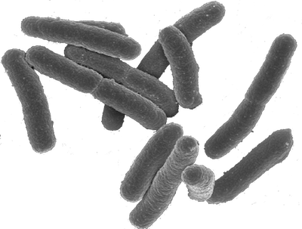
What do the units mean?
Equivalent Particles
Calibrated units are close to cell counts (but not exact)
Measure can be increased by debris, packing, expression of opaque materials
“This sample is as opaque as a suspension of this many cell-like spheres”
E. coli ≠ silica spheres
debris
packing
opacity

Slide 26
What do the units mean?
Molecules of Equivalent X (e.g., MEFL X = Fluorescein, METR X = Texas Red)
Calibrated units are close to molecule counts (but not exact)
Measure be decreased by fluorescence inhibitors (e.g., slow folding, lack of oxygen)
“This sample is as fluorescent as this many molecules of fluorescein”
Fluorescein ≠ GFP

Slide 27
Summary
Plate reader calibration is simple, cheap, and reliable
Use consistent settings and recalibrate at least monthly
Calibration can detect problems with instrument or configuration
Automated validation software is provided by iGEM
Calibrated units are close to cell count & molecule count (but not identical)
Some types of conditions can cause large value changes

Slide 28
Interpreting & Debugging Plate Reader Data
Jacob Beal
iGEM Measurement Summer Webinar: Quantifying fluorescence and cell count with plate readers
July 14th, 2020
This document does not contain technology or technical data controlled under either U.S. International Traffic in Arms Regulation or U.S. Export Administration Regulations.

Slide 29
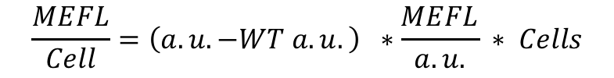
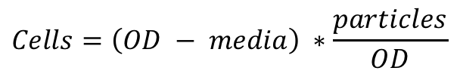
Estimating cell and molecule counts
Raw readings include background, even after calibration
To get accurate estimates, subtract background:
$$Cells=\left(OD − media\right) ∗\frac{particles}{OD}$$
$$\frac{MEFL}{Cell}=\left(a.u. −WT a.u.\right) ∗\frac{MEFL}{a.u.} ∗ Cells$$
Calibration Excel templates do cell estimate and MEFL conversion, but not WT subtraction

Slide 30
Gene expression → geometric statistics
Use geometric statistics in analysis:
Strongest fraction may dominate population
Why geometric stats?
Complex catalytic reactions → multiply many rates:
R_{express} = R₁R₂R₃R₄R₅…
Central Limit Theorem → converge to log-normal!
Gamma distribution bursting also implies geometric stats
[Davidsohn et al., 2015], [Beal, 2017]

Slide 31
How to Compute Geometric Statistics
Geometric statistics are just normal (arithmetic) statistics on a logarithmic scale:
Geometric mean = 10^(mean(log10(data)))
Geometric std.dev. = 10^(std(log10(data)))
Consequences:
Error bars no longer “plus/minus”
Instead: k-fold “times/divide”
Example of geometric vs. arithmetic statistics on per-cell fluorescence data:

Slide 32
What about zero?
Net absorbance, fluorescence may be at or below zero
Invalid on the log scale!
Really this is just giving an instrument limit:
Interpret as “< value” rather than zero (e.g., “MEFL/cell < 470”, “cells < 1.3e6”)
% Values close to autofluorescence / media indistinguishable from background
% geometric, because cells dominate
autofluorescence_std = geostd(negative_control_replicates);
indistinguishable_MEFL = autofluorescence_mean*(autofluorescence_std^2-1);
% arithmetic, because instrument error dominates
media_std = std(media_replicates);
indistinguishable_cells = 2*media_std;

Slide 33
Experimental vs. Process Controls
Experimental Controls:
Is my hypothesis true?
One control per factor under study
Best when new data
Control very close to experiment conditions
Process Controls:
Should I trust the data?
One control per assumption in study
Best when known value
Control should have minimal relation to experiment conditions

Slide 34
Experimental vs. Process Controls
GFP
Experimental Controls:
Process Controls:
GFP
RFP
GFP
RFP
RFP
wild type cells
ERF beads
media only
focusing fluid
null transfection

Slide 35
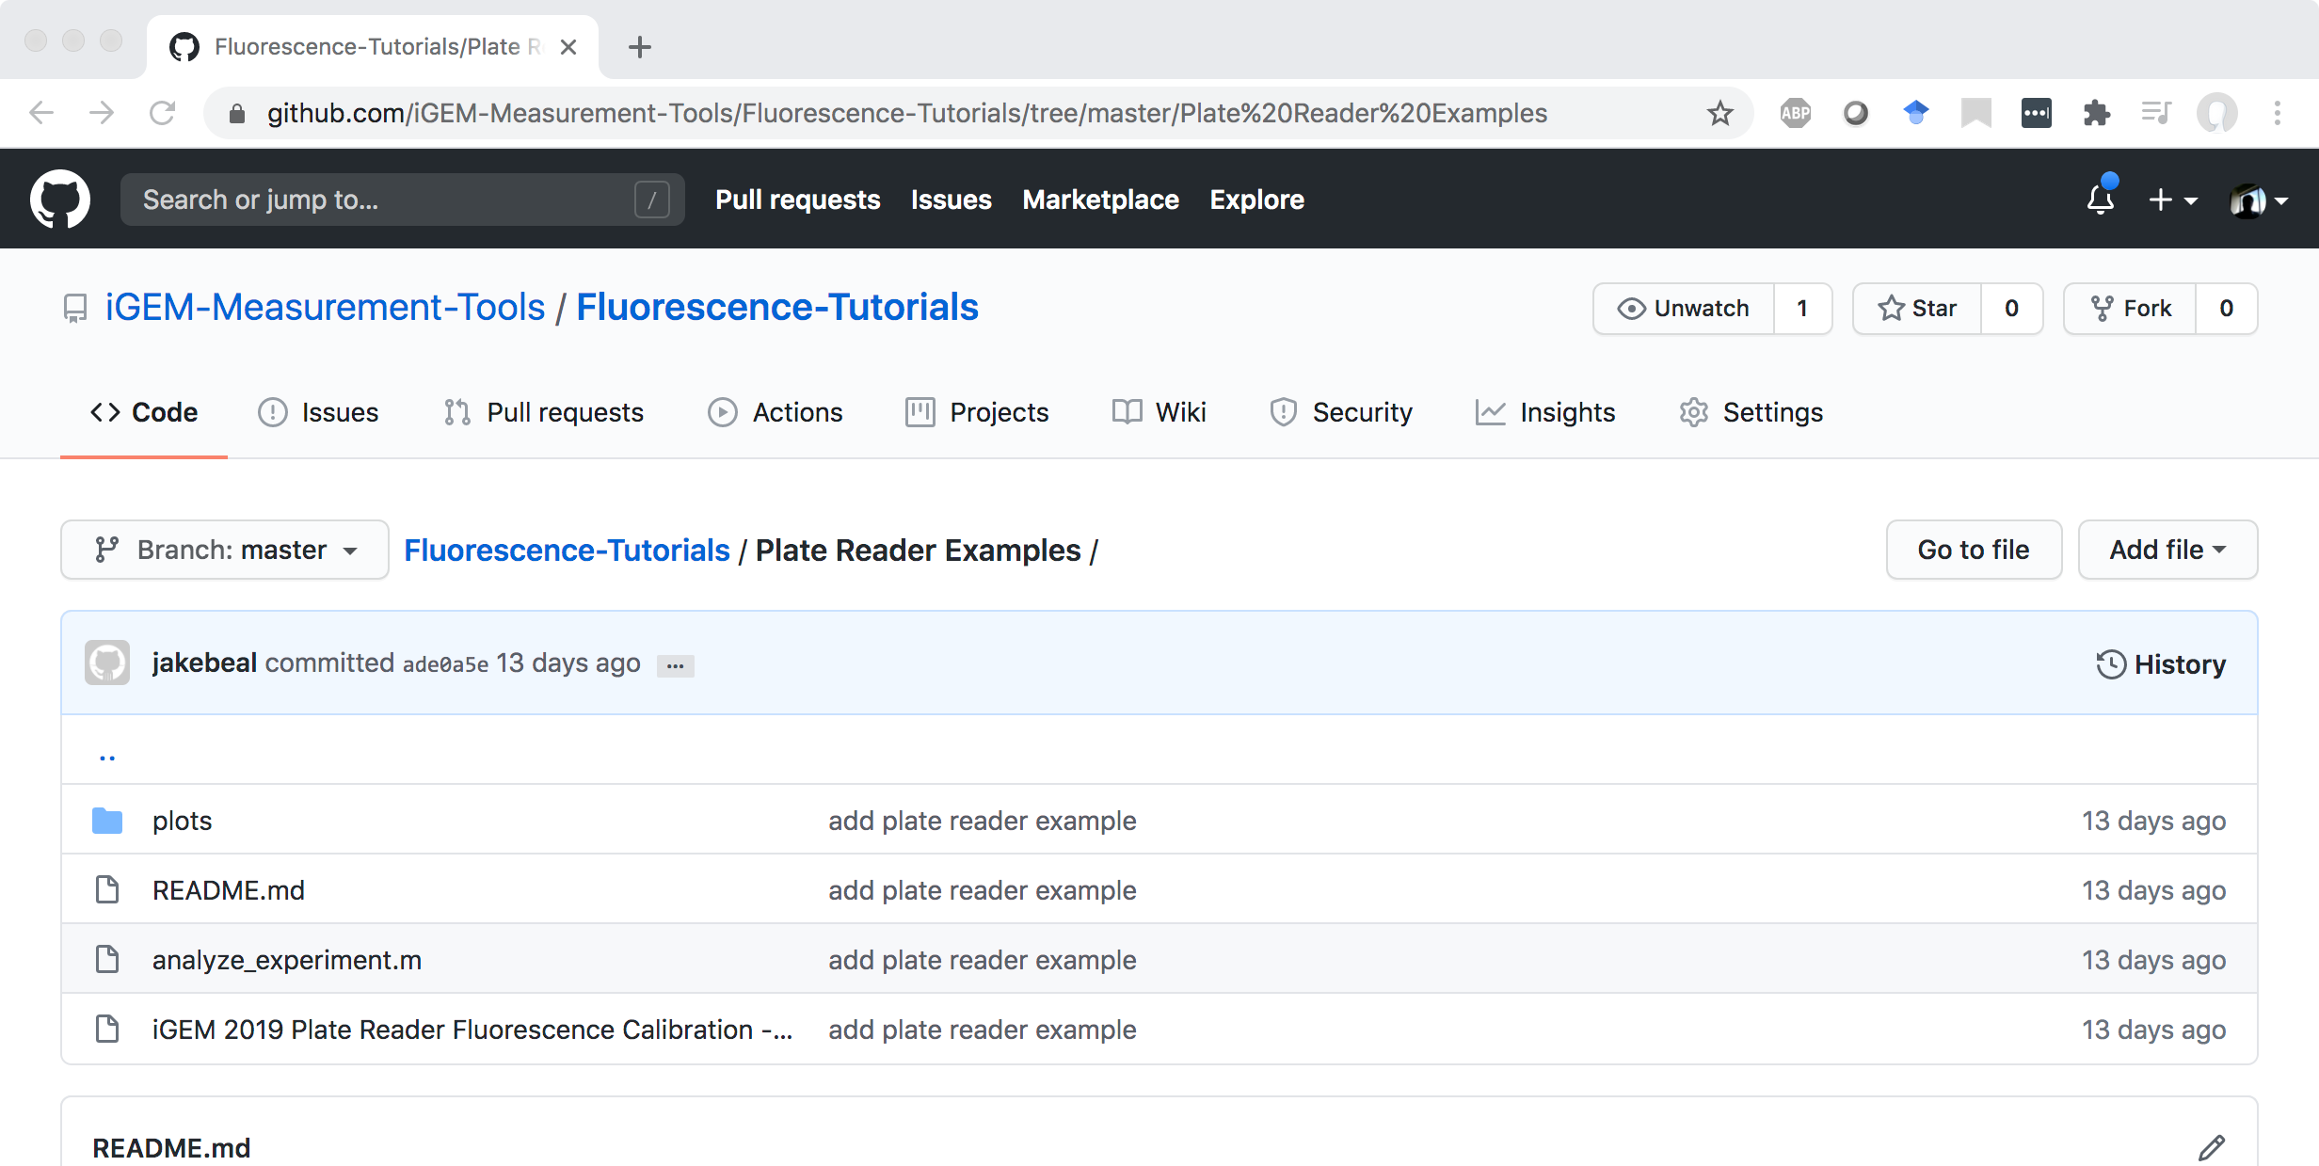
Example Data to Analyze
https://github.com/iGEM-Measurement-Tools/Fluorescence-Tutorials

Slide 36
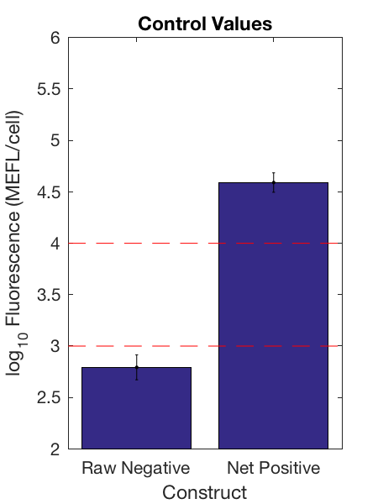
Sanity Check Control Values
Compare to calibrants to ensure instrument linear range
Compare positive to max number of proteins per cell:
E. coli: 2e6
Yeast: 6e7
Human: 2e9
Negative control should be much smaller than positive
Problems with these values indicate likely process failure
Example: E. coli negative <1e3, positive >1e4
http://book.bionumbers.org/how-many-proteins-are-in-a-cell/

Slide 37
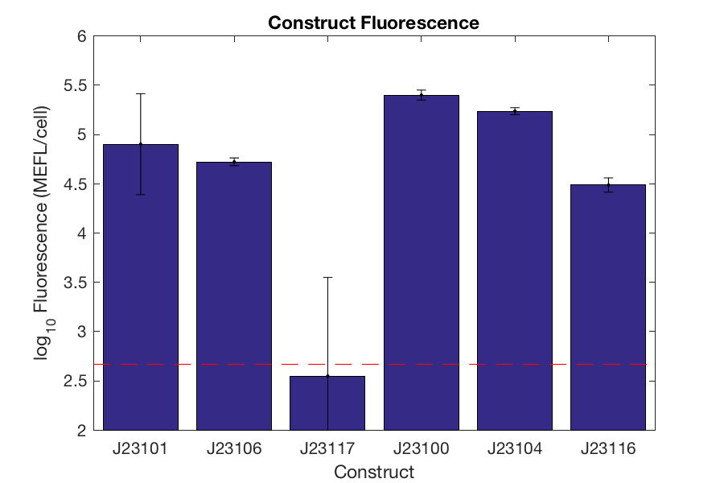
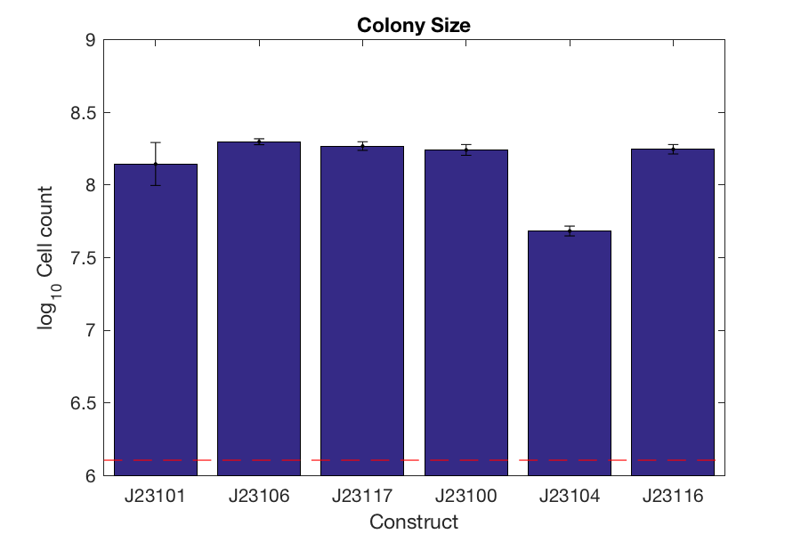
Example of Experimental Data
Colonies have generally grown well
Constructs are covering full reasonable range of gene expression, except medium-low

Slide 38
Summary
Calibrated units can be converted to estimates of cell / molecule count
Gene expression should be analyzed using geometric statistics
Low values are indistinguishable from background
Data can be interpreted in relation to realistic biological values
Positive and negative controls can detect process failures
Experimental values can be related to biological intuitions

